Slide 1
Object Oriented Programming
Objects, Inheritance, Encapsulation
Java
FRC Java
ArmSystem Example

Slide 2
Bigger Object 27
Object 1
Parameter 1
Parameter 2
Function A
Function B
Function 27.A
Function 27.B
Function 27.C
Function 27.D
Function 27.E
Function 27.F
Object 2
Parameter 1
Function C
Object 3A
Parameter 1
Object 3
Function D

Slide 3
Talon
Port
Inverted
Speed Controller
set(speed)
Digital Input (Limit Switch)
Port
get()
Sensor
Port
get()

Slide 4
Linear Actuator
Talon Speed Controller
move(speed)
moveUp()
moveDown()
isTop()
isBottom()
Top Limit Switch
Bottom Limit Switch

Slide 5
ArmSystem
PIDController
Linear Actuator
moveArm(speed)
moveArmUp()
moveArmDown()
moveArmTop()
moveArmBottom()
moveArmHome()
moveArmOffHome()
saveHomeSetpoint()
setArmSetpoint(ix)
moveArmSetpoint()
isOnTarget()
isTop()
isBottom()
isHome()
initArmPID()
Etc.
Analog Potentiometer
Home Limit Switch

Slide 6
Java Basic
http://docs.oracle.com/javase/tutorial/
http://docs.oracle.com/javase/tutorial/java/concepts/index.html
FRC Java
https://wpilib.screenstepslive.com/s/4485/m/13809
RobotBuilder
https://wpilib.screenstepslive.com/s/4485/m/26402
WPILib
http://first.wpi.edu/FRC/roborio/release/docs/java/

Slide 7
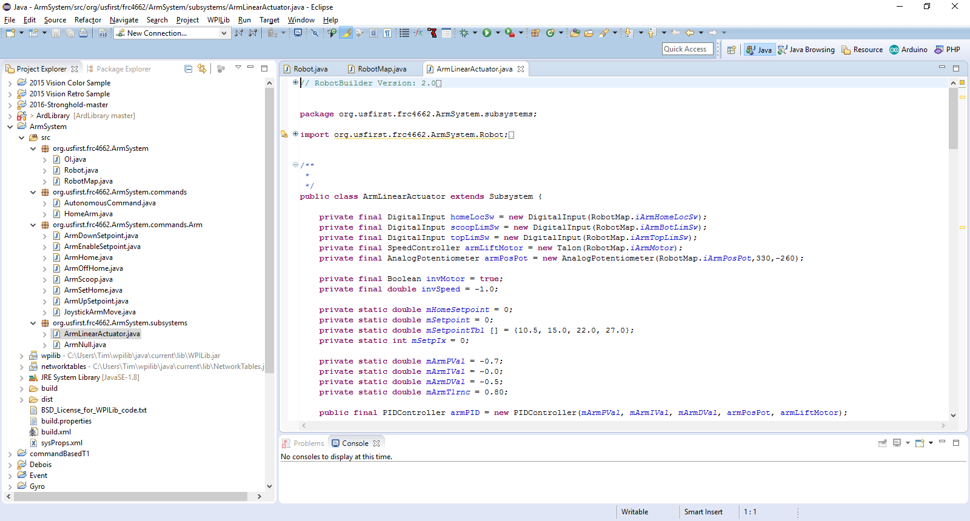
Eclipse IDE
Integrated Development Environment
Open Source eclipse.org
Add-ons for many languages
Real-time syntax and reference validation
WPIlib extensions for FRC authorized objects
3rd party support for optional add-ons
e.g. Original Equipment Manufacturers may provide Java/C++ code for their products as either samples or libraries
https://eclipse.org/home

Slide 8
Eclipse
ArmSystem

Slide 9
EXERCISES
Arm System
Initialize (replace current autonomous)
Fix isOnTarget logic
Capture Setpoint Values into Table
Read Setpoint Table from File
Save Setpoint Table to File

